Slide 1
Lecture-6,7,8: Number Theory
Part I: Modular Arithmetic, Congruence,
and Matrices
2.<number>
Copyright © The McGraw-Hill Companies, Inc. Permission required for reproduction or display.

Slide 2
Objectives
To review integer arithmetic, concentrating on divisibility
and finding the greatest common divisor using the Euclidean
algorithm
To understand how the extended Euclidean algorithm can be
used to solve linear Diophantine equations, to solve linear
congruent equations, and to find the multiplicative inverses
To emphasize the importance of modular arithmetic and
the modulo operator, because they are extensively used in
cryptography
To emphasize and review matrices and operations on residue
matrices that are extensively used in cryptography
To solve a set of congruent equations using residue matrices
2.<number>

Slide 3
INTEGER ARITHMETIC
In integer arithmetic, we use a set and a few operations. You are familiar with this set and the corresponding operations, but they are reviewed here to create a background for modular arithmetic.
Topics discussed in this section:
Set of Integers
Binary Operations
Integer Division
Divisibility
Linear Diophantine Equations
2.<number>

Slide 4

Set of Integers
The set of integers, denoted by Z, contains all integral numbers (with no fraction) from negative infinity to positive infinity (Figure 2.1).
Figure The set of integers
2.<number>

Slide 5
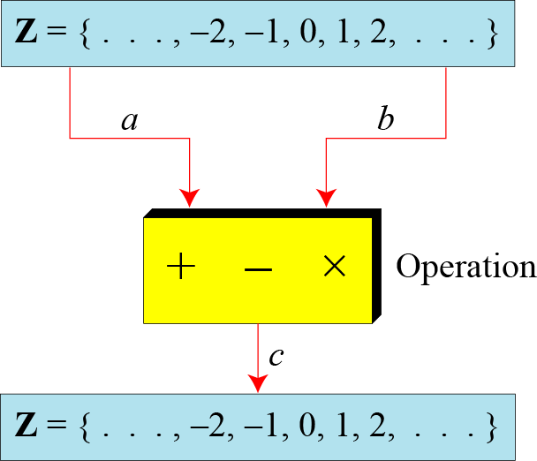
Binary Operations
In cryptography, we are interested in three binary operations applied to the set of integers. A binary operation takes two inputs and creates one output.
Figure Three binary operations for the set of integers
2.<number>

Slide 6
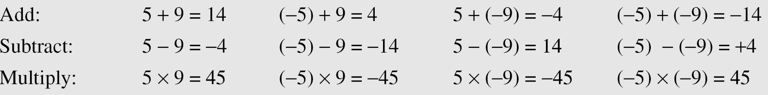
Continued
Example
The following shows the results of the three binary operations on two integers. Because each input can be either positive or negative, we can have four cases for each operation.
2.<number>

Slide 7
Integer Division
In integer arithmetic, if we divide a by n, we can get q
And r . The relationship between these four integers can be shown as
a = q × n + r
2.<number>

Slide 8
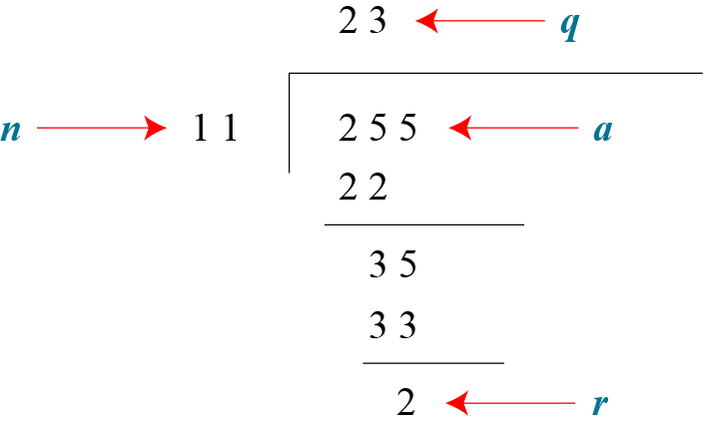
Continued
Example
Assume that a = 255 and n = 11. We can find q = 23 and R = 2 using the division algorithm.
Figure finding the quotient and the remainder
2.<number>

Slide 9
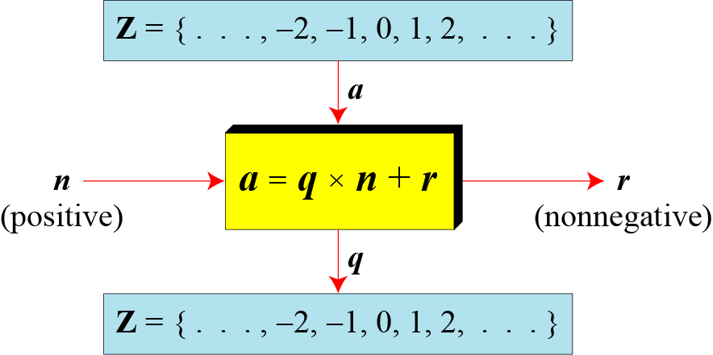
Continued
Figure Division algorithm for integers
2.<number>

Slide 10

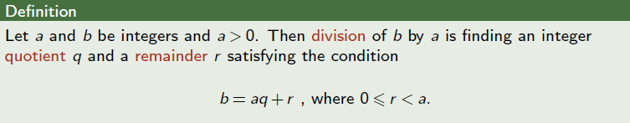
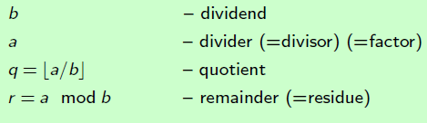
Divisibility: continued

Slide 11
Continued
Example
When we use a computer or a calculator, r and q are negative when a is negative. How can we apply the restriction that r needs to be positive? The solution is simple, we decrement the value of q by 1 and we add the value of n to r to make it positive.
2.<number>

Slide 12

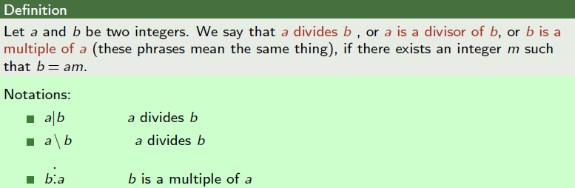

Slide 13


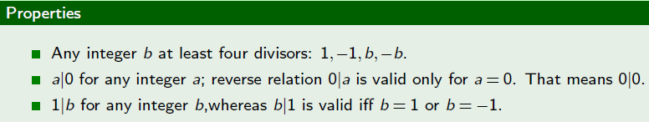

Slide 14
Divisbility
If b is not zero and we let r = 0 in the division relation, we get
b = a × m
If the remainder is zero,
If the remainder is not zero,
2.<number>

Slide 15
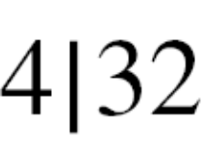
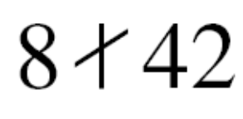
Continued
Example
The integer 4 divides the integer 32 because 32 = 8 × 4. We show this as
b. The number 8 does not divide the number 42 because
42 = 5 × 8 + 2. There is a remainder, the number 2, in the equation. We show this as
2.<number>

Slide 16
Continued
Example
2.<number>

Slide 17
Continued
Properties
Property 1: if a|1, then a = ±1.
Property 2: if a|b and b|a, then a = ±b.
Property 3: if a|b and b|c, then a|c.
Property 4: if a|b and a|c, then
a|(m × b + n × c), where m
and n are arbitrary integers
2.<number>

Slide 18

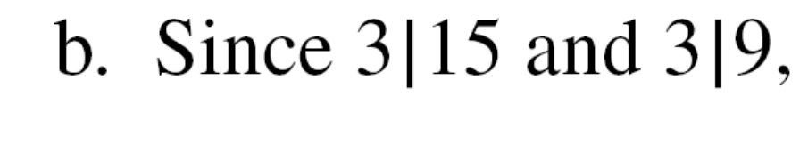
Continued
Example
2.<number>

Slide 19

Continued
Note
Fact 1: The integer 1 has only one
divisor, itself.
Fact 2: Any positive integer has at least
two divisors, 1 and itself (but it
can have more).
2.<number>

Slide 20
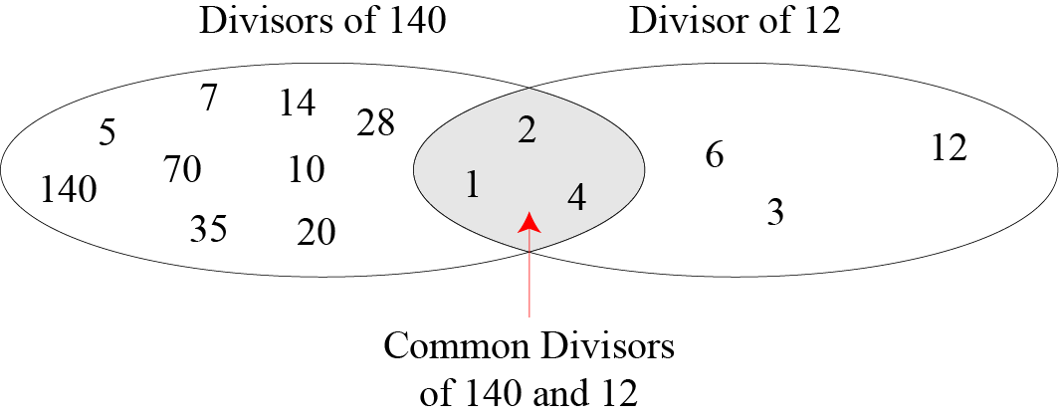
Continued
Figure Common divisors of two integers
2.<number>

Slide 21
Continued
Note
Greatest Common Divisor
The greatest common divisor of two positive integers is the largest integer that can divide both integers.
Note
Euclidean Algorithm
Fact 1: gcd (a, 0) = a
Fact 2: gcd (a, b) = gcd (b, r), where r is
the remainder of dividing a by b
2.<number>

Slide 22
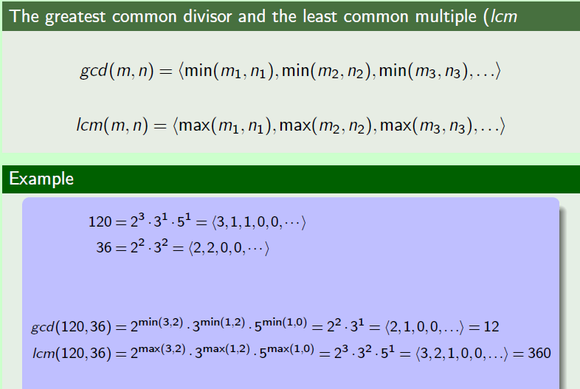

Slide 23
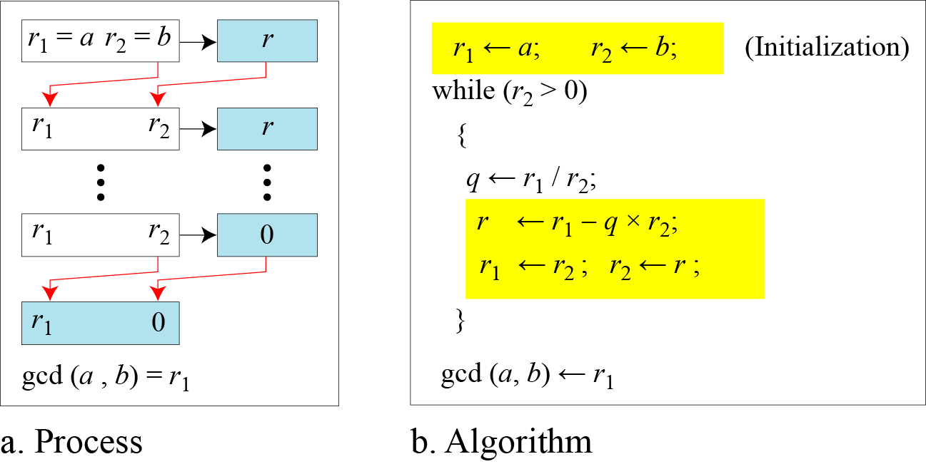
Continued
Figure Euclidean Algorithm
Note
When gcd (a, b) = 1, we say that a and b are relatively prime.
2.<number>

Slide 24

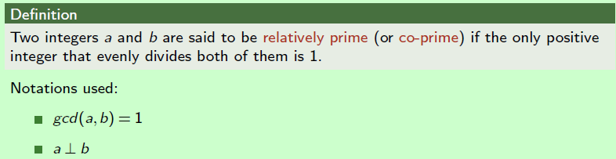
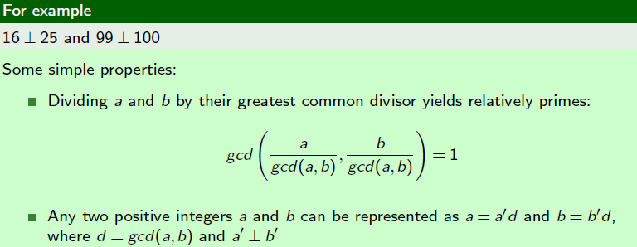

Slide 25
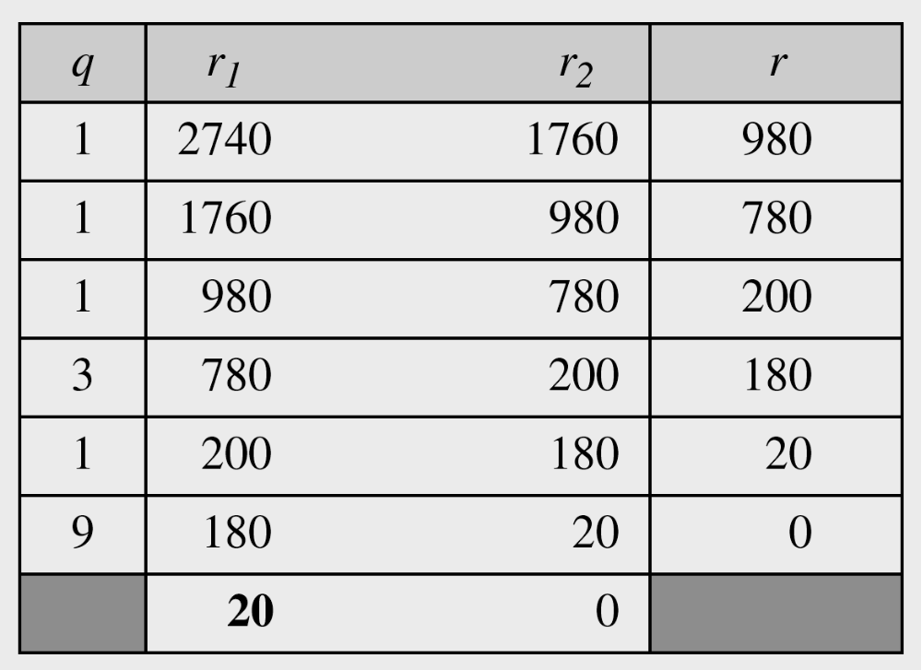
Continued
Example
Find the greatest common divisor of 2740 and 1760.
Solution
We have gcd (2740, 1760) = 20.
2.<number>

Slide 26
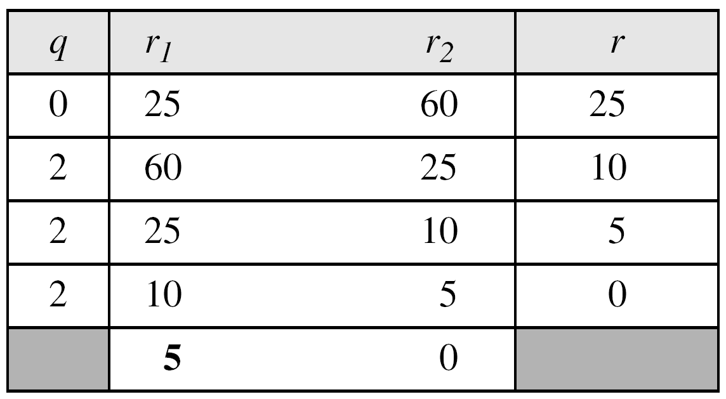
Continued
Example
Find the greatest common divisor of 25 and 60.
Solution
We have gcd (25, 65) = 5.
2.<number>

Slide 27

Continued
Extended Euclidean Algorithm
Given two integers a and b, we often need to find other two integers, s and t, such that
The extended Euclidean algorithm can calculate the gcd (a, b) and at the same time calculate the value of s and t.
2.<number>

Slide 28
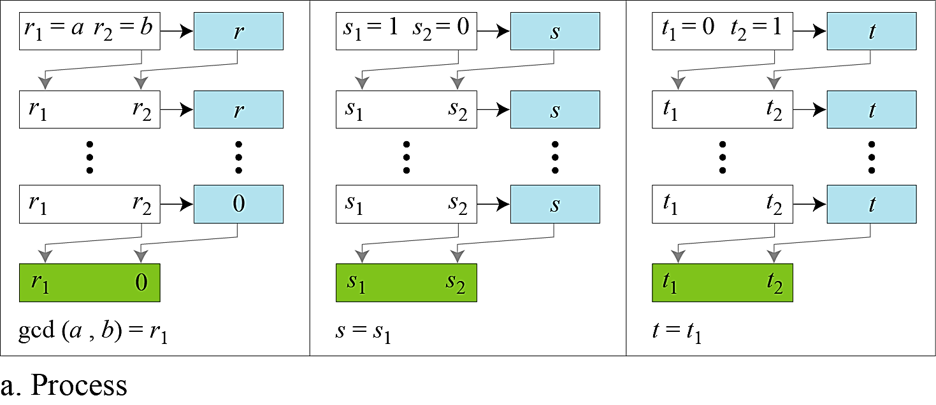
Continued
Figure a Extended Euclidean algorithm, part a
2.<number>

Slide 29
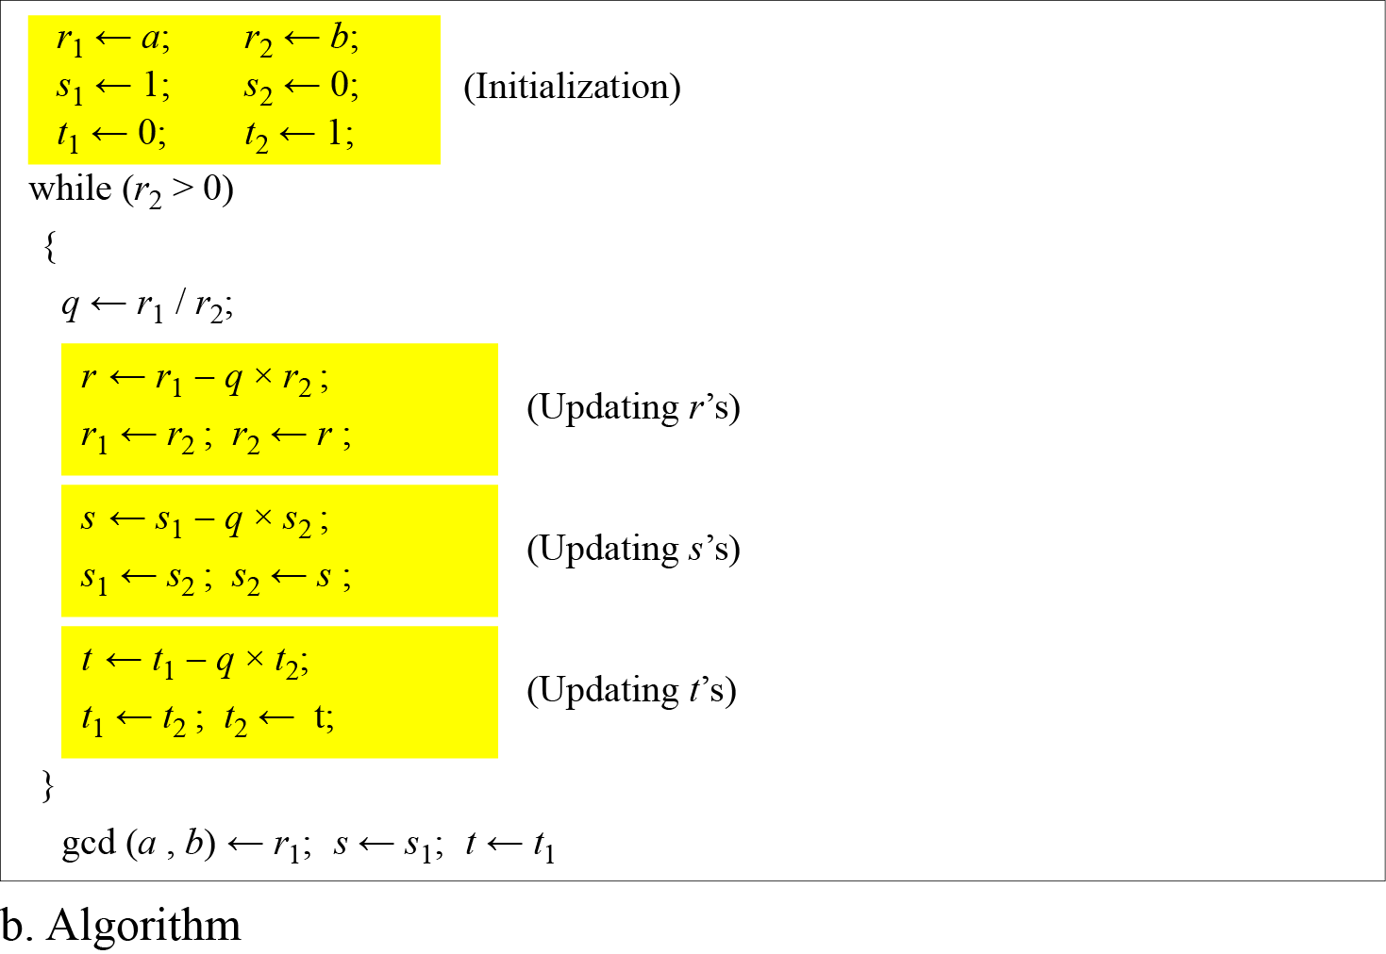
Continued
Figure b Extended Euclidean algorithm, part b
2.<number>

Slide 30
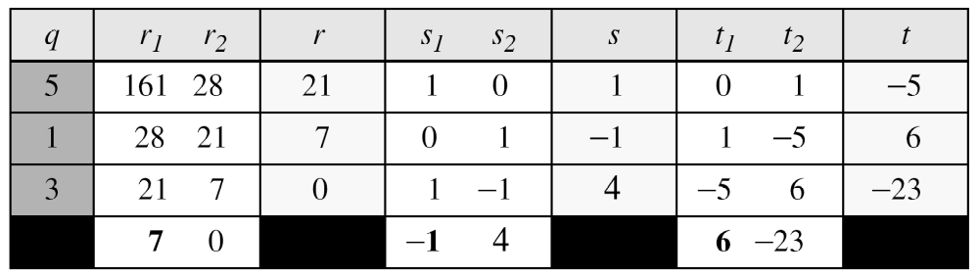
Continued
Example
Given a = 161 and b = 28, find gcd (a, b) and the values of s and t.
Solution
We get gcd (161, 28) = 7, s = −1 and t = 6.
2.<number>

Slide 31
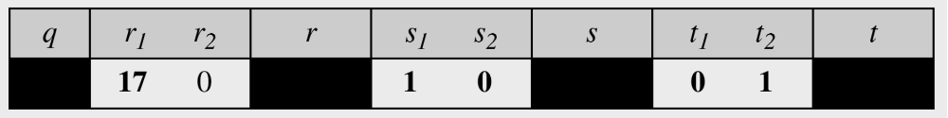
Continued
Example
Given a = 17 and b = 0, find gcd (a, b) and the values of s
and t.
Solution
We get gcd (17, 0) = 17, s = 1, and t = 0.
2.<number>

Slide 32
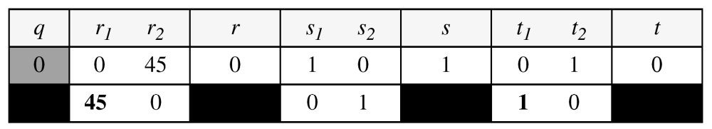
Continued
Example
Given a = 0 and b = 45, find gcd (a, b) and the values of s
and t.
Solution
We get gcd (0, 45) = 45, s = 0, and t = 1.
2.<number>

Slide 33
MODULAR ARITHMETIC
The division relationship (a = q × n + r) discussed in the previous section has two inputs (a and n) and two outputs (q and r). In modular arithmetic, we are interested in only one of the outputs, the remainder r.
Topics discussed in this section:
Modular Operator
Set of Residues
Congruence
Operations in Z_{n}
Addition and Multiplication Tables
Different Sets
2.<number>

Slide 34
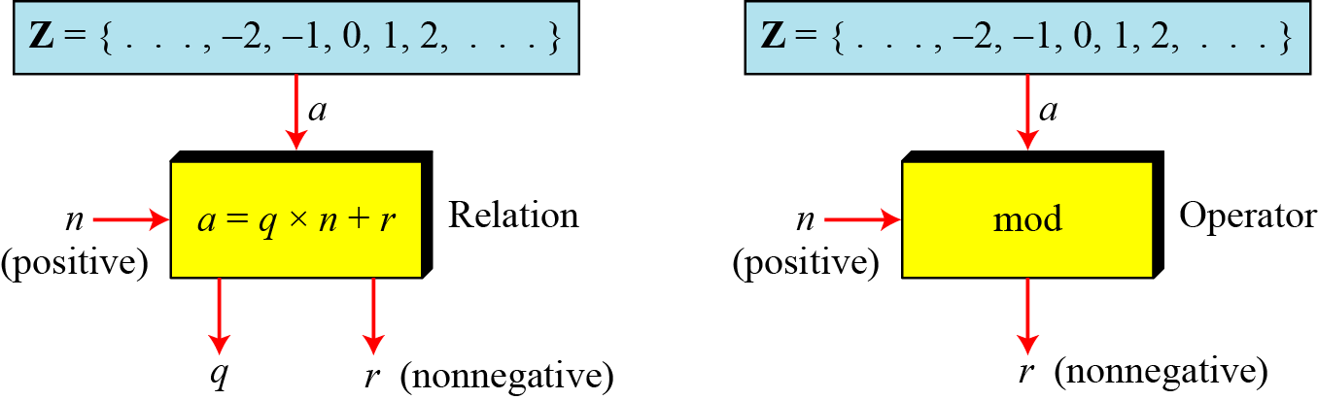
Modulo Operator
The modulo operator is shown as mod. The second input (n) is called the modulus. The output r is called the residue.
Figure Division algorithm and modulo operator
2.<number>

Slide 35
Continued
Example
Find the result of the following operations:
a. 27 mod 5 b. 36 mod 12
c. −18 mod 14 d. −7 mod 10
Solution
Dividing 27 by 5 results in r = 2
Dividing 36 by 12 results in r = 0.
c. Dividing −18 by 14 results in r = −4. After adding the modulus r = 10
d. Dividing −7 by 10 results in r = −7. After adding the modulus to −7, r = 3.
2.<number>

Slide 36
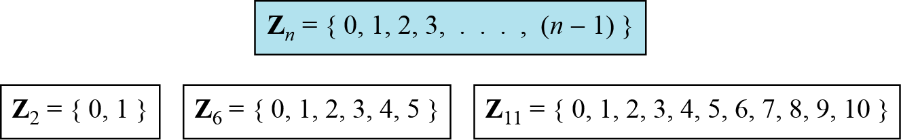
Set of Residues
The modulo operation creates a set, which in modular arithmetic is referred to as the set of least residues modulo n, or Z_{n}.
Figure Some Z_{n} sets
2.<number>

Slide 37
Continued
Example
We use modular arithmetic in our daily life; for example, we use a clock to measure time. Our clock system uses modulo 12 arithmetic. However, instead of a 0 we use the number 12.
2.<number>

Slide 38
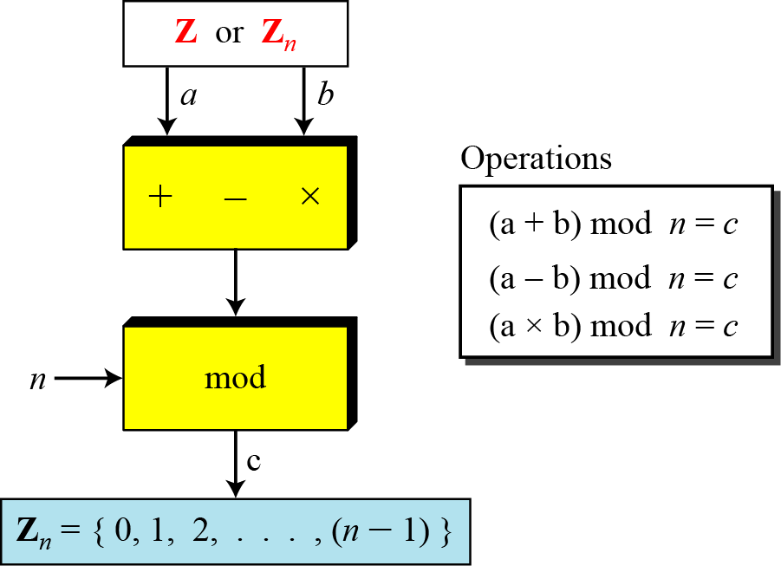
Operation in Z_{n}
The three binary operations that we discussed for the set Z can also be defined for the set Zn. The result may need to be mapped to Zn using the mod operator.
Figure Binary operations in Z_{n}
2.<number>

Slide 39
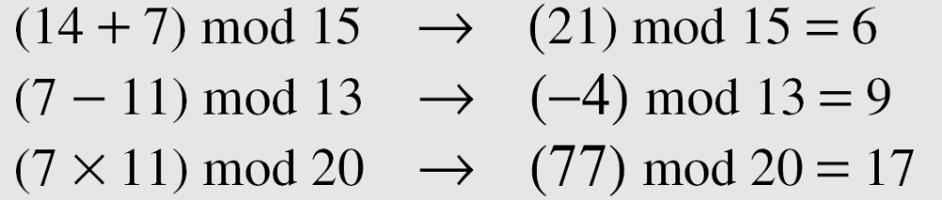
Continued
Example
Perform the following operations (the inputs come from Zn):
  a. Add 7 to 14 in Z15.
  b. Subtract 11 from 7 in Z13.
  c. Multiply 11 by 7 in Z20.
Solution
2.<number>

Slide 40
Continued
Example
Perform the following operations (the inputs come from either Z or Z_{n}):
a. Add 17 to 27 in Z₁₄.
b. Subtract 43 from 12 in Z₁₃.
c. Multiply 123 by −10 in Z₁₉.
Solution
2.<number>

Slide 41
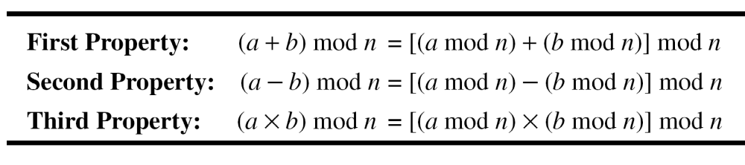
Continued
Properties
2.<number>

Slide 42
Continued
Example
The following shows the application of the above properties:
1. (1,723,345 + 2,124,945) mod 11 = (8 + 9) mod 11 = 6
2. (1,723,345 − 2,124,945) mod 16 = (8 − 9) mod 11 = 10
3. (1,723,345 × 2,124,945) mod 16 = (8 × 9) mod 11 = 6
11⁷ mod 13 ?
2.<number>

Slide 43
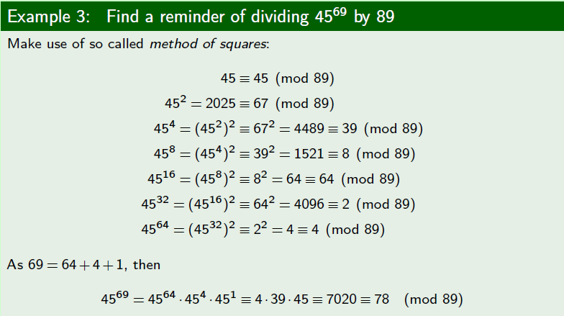

Slide 44
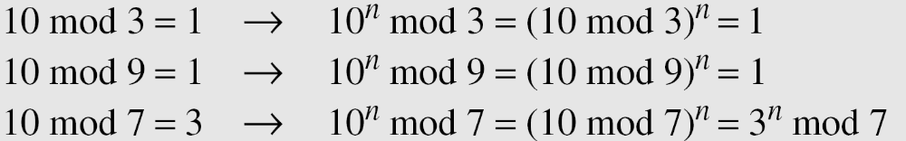
Continued
Example
In arithmetic, we often need to find the remainder of powers of 10 when divided by an integer.
2.<number>

Slide 45
Inverses
When we are working in modular arithmetic, we often need to find the inverse of a number relative to an operation. We are normally looking for an additive inverse (relative to an addition operation) or a multiplicative inverse (relative to a multiplication operation).
2.<number>

Slide 46

Continue
Additive Inverse
In Z_{n}, two numbers a and b are additive inverses of each other if
Note
In modular arithmetic, each integer has an additive inverse. The sum of an integer and its additive inverse is congruent to 0 modulo n.
2.<number>

Slide 47
Continued
Example
Find all additive inverse pairs in Z10.
Solution
The six pairs of additive inverses are (0, 0), (1, 9), (2, 8), (3, 7), (4, 6), and (5, 5).
2.<number>

Slide 48

Continue
Multiplicative Inverse
In Z_{n}, two numbers a and b are the multiplicative inverse of each other if
Note
In modular arithmetic, an integer may or may not have a multiplicative inverse.
When it does, the product of the integer and its multiplicative inverse is congruent to 1 modulo n.
2.<number>

Slide 49
Continued
Example
Find the multiplicative inverse of 8 in Z₁₀.
Solution
There is no multiplicative inverse because gcd (10, 8) = 2 ≠ 1. In other words, we cannot find any number between 0 and 9 such that when multiplied by 8, the result is congruent to 1.
Example
Find all multiplicative inverses in Z₁₀.
Solution
There are only three pairs: (1, 1), (3, 7) and (9, 9). The numbers 0, 2, 4, 5, 6, and 8 do not have a multiplicative inverse.
2.<number>

Slide 50
Continued
Example
Find all multiplicative inverse pairs in Z₁₁.
Solution
We have seven pairs: (1, 1), (2, 6), (3, 4), (5, 9), (7, 8), (9, 5), and (10, 10).
2.<number>

Slide 51
Continued
Note
The extended Euclidean algorithm finds the multiplicative inverses of b in Z_{n} when n and b are given and
gcd (n, b) = 1.
The multiplicative inverse of b is the value of t after being mapped to Z_{n}.
2.<number>

Slide 52
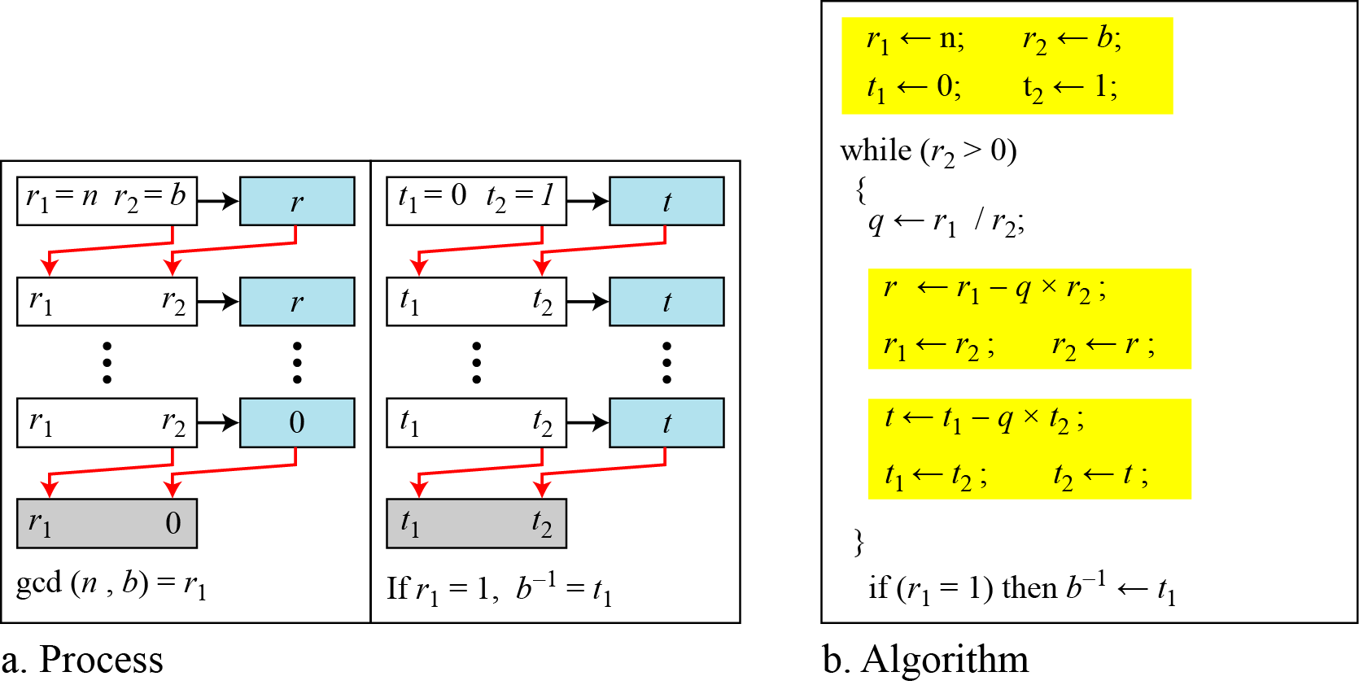
Continued
Figure Using extended Euclidean algorithm to
find multiplicative inverse
2.<number>

Slide 53
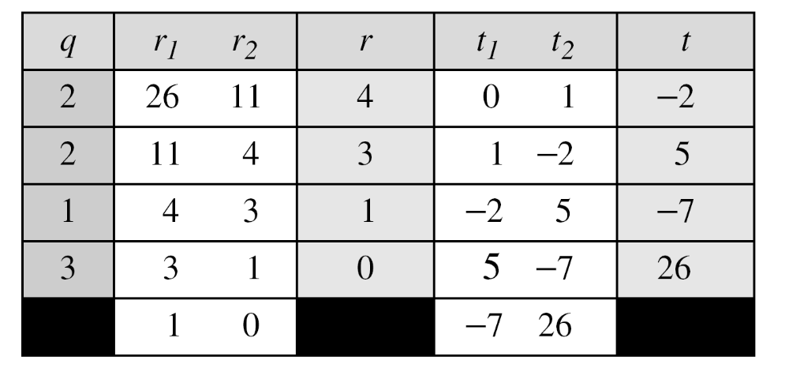
Continued
Example
Find the multiplicative inverse of 11 in Z₂₆.
Solution
The gcd (26, 11) is 1; the inverse of 11 is −7 or 19.
2.<number>

Slide 54
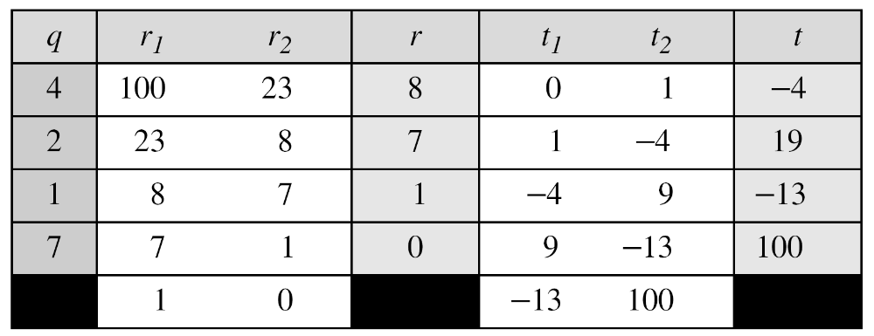
Continued
Example
Find the multiplicative inverse of 23 in Z₁₀₀.
Solution
The gcd (100, 23) is 1; the inverse of 23 is −13 or 87.
2.<number>

Slide 55
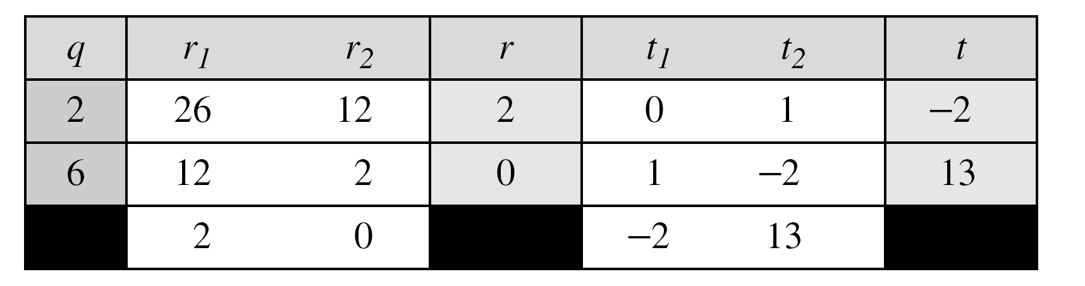
Continued
Example
Find the inverse of 12 in Z₂₆.
Solution
The gcd (26, 12) is 2; the inverse does not exist.
2.<number>

Slide 56
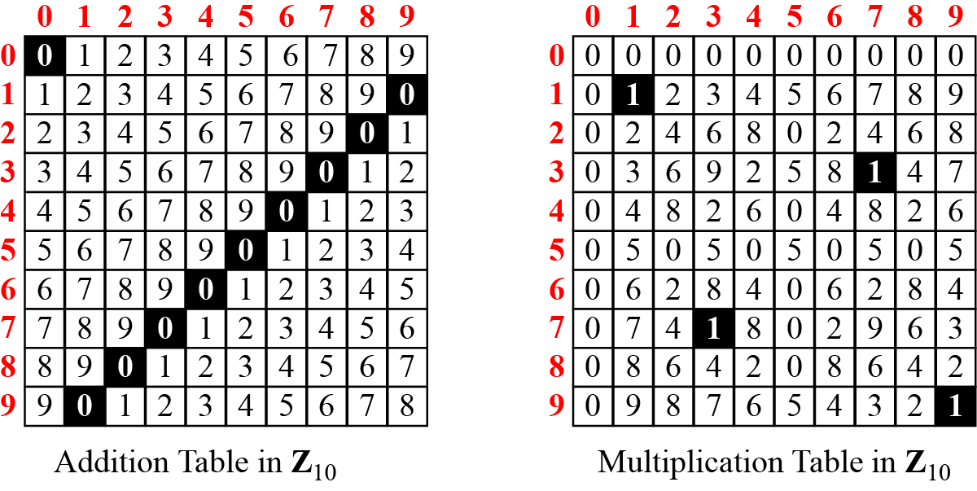
Addition and Multiplication Tables
Figure Addition and multiplication table for Z₁₀
2.<number>

Slide 57
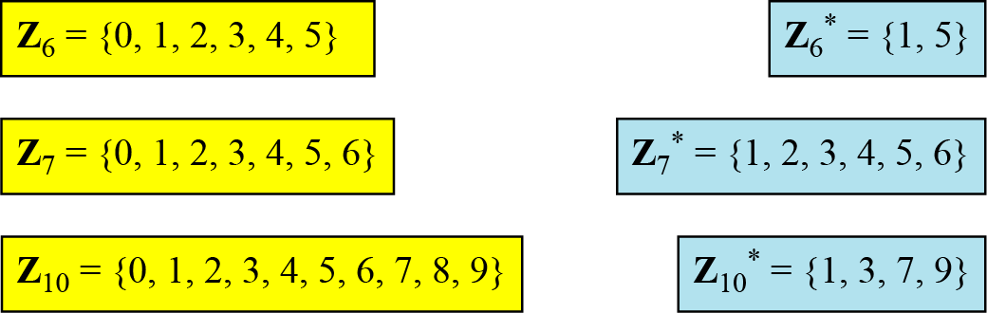
Different Sets
Figure Some Z_{n} and Z_{n}* sets
Note
We need to use Zn when additive inverses are needed; we need to use Zn* when multiplicative inverses are needed.
2.<number>

Slide 58
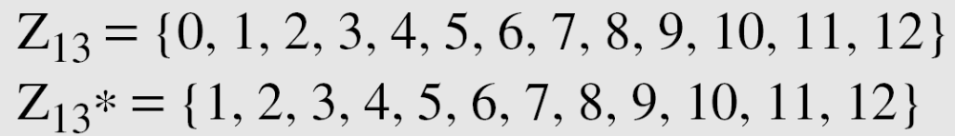
Two More Sets
Cryptography often uses two more sets: Z_{p} and Z_{p}*. The modulus in these two sets is a prime number.
2.<number>

Slide 59
LINEAR CONGRUENCE
Cryptography often involves solving an equation or a set of equations of one or more variables with coefficient in Z_{n}. This section shows how to solve equations when the power of each variable is 1 (linear equation).
Topics discussed in this section:
Single-Variable Linear Equations
Set of Linear Equations
2.<number>

Slide 60

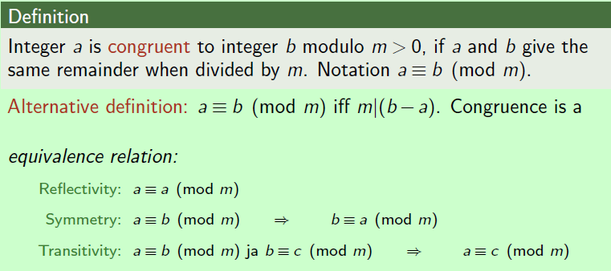

Slide 61
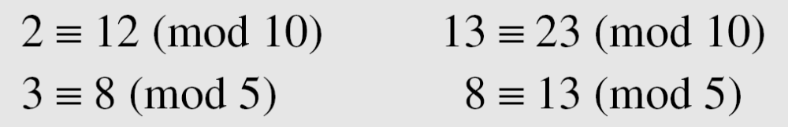
Congruence
To show that two integers are congruent, we use the congruence operator ( ≡ ). For example, we write:
2.<number>

Slide 62
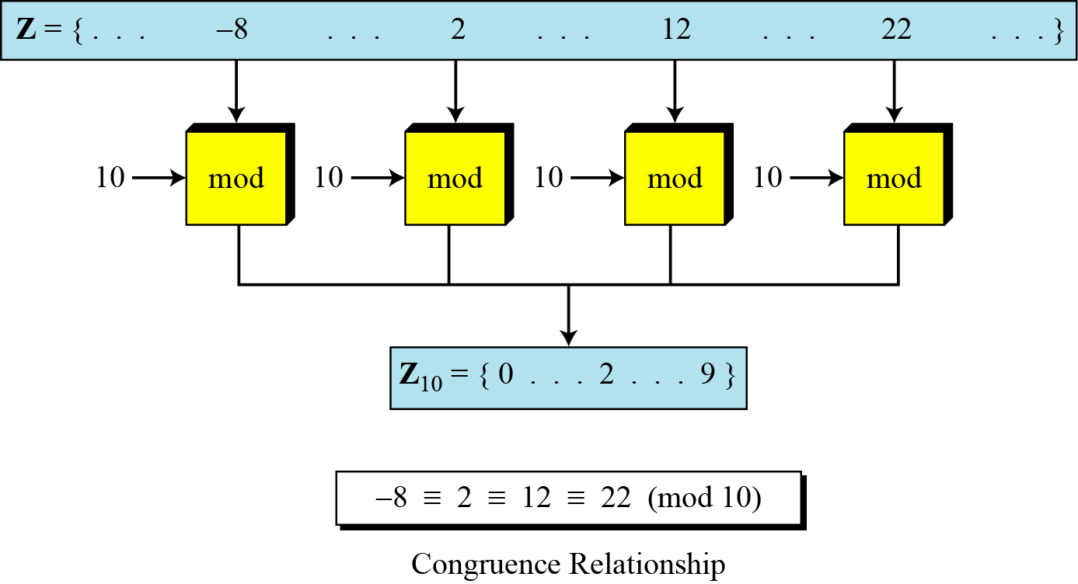
Continued
Figure Concept of congruence
2.<number>

Slide 63



Single-Variable Linear Equations
Equations of the form ax ≡ b (mod n ) might have no solution or a limited number of solutions.
2.<number>

Slide 64
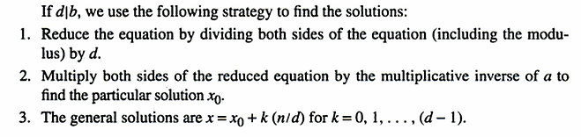
Steps to solve congruence
2.<number>

Slide 65
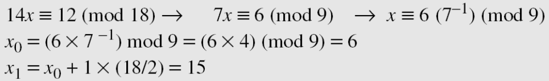
Continued
Example
Solve the equation 10 x ≡ 2(mod 15).
Solution
First we find the gcd (10 and 15) = 5. Since 5 does not divide 2, we have no solution.
Example
Solve the equation 14 x ≡ 12 (mod 18).
Solution
2.<number>

Slide 66
Continued
Example
Solve the equation 3x + 4 ≡ 6 (mod 13).
Solution
First we change the equation to the form ax ≡ b (mod n). We add −4 (the additive inverse of 4) to both sides, which give
3x ≡ 2 (mod 13). Because gcd (3, 13) = 1, the equation has only one solution, which is x₀ = (2 × 3⁻¹) mod 13 = 18 mod 13 = 5. We can see that the answer satisfies the original equation:
3 × 5 + 4 ≡ 6 (mod 13).
2.<number>

Slide 67
Exercise
Find all solutions to the linear congruence 124x≡132(mod 900).
  Ans: 168, 393, 618, and 843.
Find all solutions to the linear congruence 120x≡52(mod119).
  Ans: 52
Verify that for the linear congruence 120x≡52(mod119), all possible values of x are in the form x = 52 + 119k.
2.<number>

Slide 68

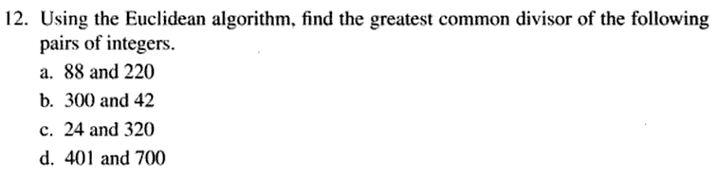
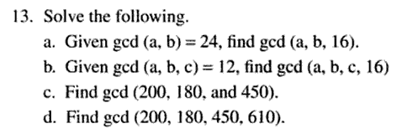
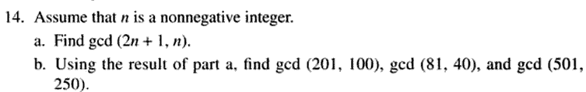
Home Task
2.<number>

Slide 69
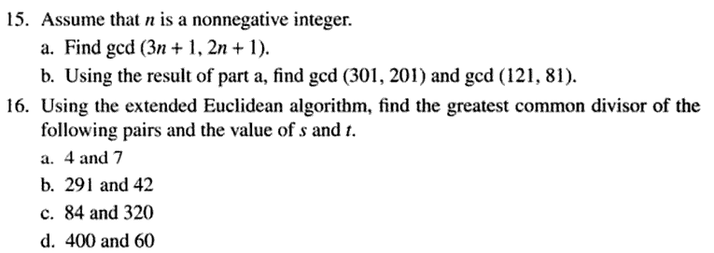
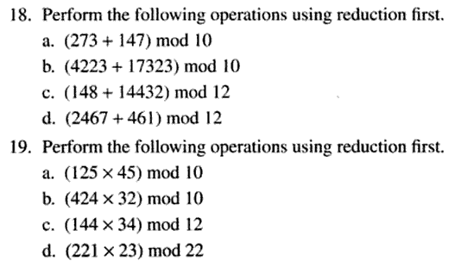
Home Task
2.<number>

Slide 70
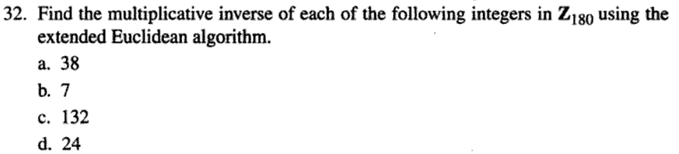
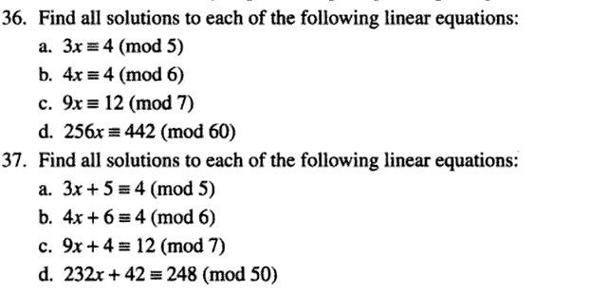
Home Task
2.<number>

